Slide 1
SPH Supervisory Excellence: Annual Performance Appraisals
Supervisory Excellence Program | SPH Human Resources
March & April 2019

Slide 2
Agenda for Today
SPH Supervisory Excellence program
Overview
Next Steps
Norms for Session
Annual Performance Appraisals (April 1, 2018 to March 30, 2019)
The Mechanics
Timeline and Steps
Writing the Review
The Art
Feedback
Next Steps

Slide 3
Supervisory Excellence
To build and support a community of supervisors in SPH committed to developing their supervisory and management skills through:
In-person trainings with opportunities to practice skills
Networking with peers
Electronic resources
Support of individual development plans and goal setting

Slide 4
Building the Supervisory Excellence Program
Kickoff Session: Program Introduction and Some Fundamentals
Inquiry: Self Assessment and Interest Inventory Survey
Spring Session: Annual Performance Appraisals
Setting our Direction: Supervisory Excellence Advisory Group
Summer Session: Building & Leading Effective Teams (separate companion sessions on large and small teams)

Slide 5
Supervisory Excellence Advisory Group
Networking & Practicing with Peers
Individualized Needs
Areas of Focus

Slide 6
Pertinent Supervisory Development Course https://supervising.umn.edu/
Module 2: Managing and Evaluating Performance
Pertinent Resource: A Quick Guide to Performance Evaluation
Setting Goals
Conducting Check Ins
Evaluating Performance

Slide 7
Proposed Norms for Supervisory Excellence Sessions
Hold stories and personal matters in confidentiality
Listen to each other with compassion and curiosity
Assume positive intent
Be present
Ask for what you need, offer what you can
Anything else?

Slide 8
The Mechanics

Slide 9
Purpose of Performance Appraisals:
Recognize accomplishments
Chronicle development
Discuss expectations
Identify goals
Provide valuable feedback
Express gratitude

Slide 10
Timeline of 2018-19 SPH Staff Performance Appraisals
Week of February 25: SPH HR initiates appraisals in AHC Performance Appraisal Tool (PAT) system
By Friday, March 29: Staff members complete their self-appraisals
By Tuesday, April 30: Supervisors complete their preliminary appraisals of their staff members
By Friday, May 17: Each of the divisions calibrate supervisors’ performance ratings to ensure fairness and consistency
Between Friday, May 17 and Friday, June 7: Most performance appraisal meetings are held
Monday, June 10: Merit pay adjustments entered into HRMS

Slide 11
Main Sections of the Appraisal Form
Emphasis on WHAT (goals & results)
Major Responsibilities
Performance Categories
Summary Rating & Comments
Responsibility; Expected results; Employee self assessment; Supervisor assessment
Emphasis on HOW (behaviors)
Job knowledge; Quality of work; Productivity quantity of work; Technical skills & ability;
Reliability; Interactions with others; Supervision (formal/informal, if applicable)
Add it all up! Show gratitude and/or encouragement.

Slide 12
Four Cardinal Rules of Performance Reviews
Provide feedback regularly.
A once-a-year performance appraisal is the floor, not the ceiling.
Nothing in the performance appraisal should be a surprise.
Just do it!
Overcome procrastination.
Overcome perfectionism.
Overcome fear.
Your employees deserve your time and attention.
The appraisal is documentation that needs to match the reality of the employee’s performance.

Slide 13
To complete the appraisal:
Carefully read the employee’s self assessment of their performance results and impact.
Review input from others with whom they interact on a regular basis (peers, direct or indirect reports, “customers/clients,” and/or faculty).
Look back at performance information for the full review period (e.g., notes, GCal, emails, work product).
Evaluate what they achieved (results within context of their goals, work plan, regular work responsibilities, projects/initiatives, any unexpected/temporary shifts of duties).
Evaluate how they achieved these results (behaviors).
Check your biases.
Provide performance ratings and meaningful narrative.

Slide 14
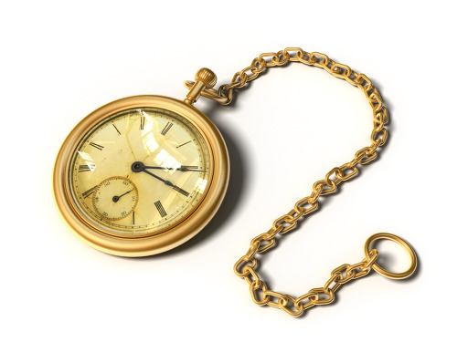
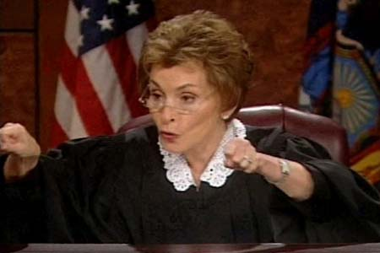
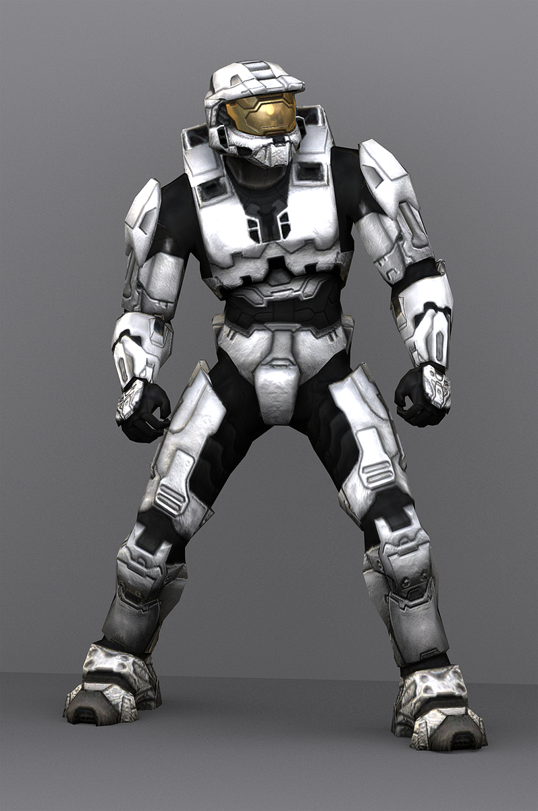
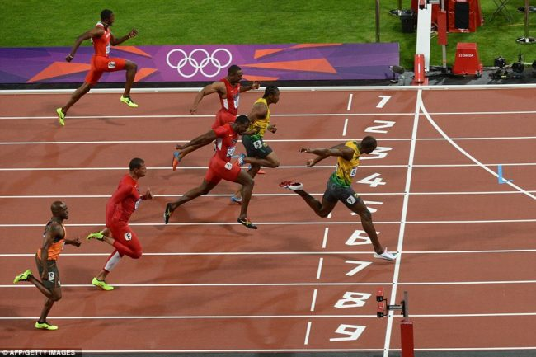

Slide 16
Meaningful Narratives about Performance:
Refer to the Academic Health Center Performance Appraisal Tool (Pat) Rating Job Aid for help
Pay attention to what performance looks like at each of the rating levels
Note that your narrative must match the performance rating you are assigning
*Remember a “meets expectations” rating reflects a job well done.*
Refer to the flip side with SPH guidance for help
Use these phrases/concepts to prompt your writing and spark ideas about specific examples and behaviors you can list and describe in your text

Slide 17
Challenges & Concerns Tips & Solutions to Review Performance
What questions or concerns do you have about the annual appraisal process?
True confessions: Are you facing any particular challenges (e.g., haven’t provided regular feedback, anticipate that some feedback will be a surprise)?
What challenges are you facing on articulating your feedback and phrasing your narrative?

Slide 18
Discuss Equity, Diversity & Inclusion
In This Year’s Instructions:
As a school community, we recognize that different perspectives make us stronger and strive to be a leader in university efforts to build a more equitable, diverse, and inclusive climate. That’s why we are introducing the area of diversity into staff annual performance review discussions this year.
Talking about this value and setting related goals will help us better realize our individual goal to make diversity our everyday work. Here are conversation prompts for supervisors to incorporate the advancement of equity, diversity, and inclusion in the annual performance discussion:
What are your goals for this next year to gain new knowledge or insights in the area of equity, diversity, and inclusion?
How does an appreciation of differences impact your work or become integrated in what you do in your job on a regular basis?
What specific contributions will you make to diversity efforts within the university, school, division, or unit?
How can I as your supervisor support you in setting and attaining these goals?

Slide 19
The Art

Slide 20
Pertinent Supervisory Development Course https://supervising.umn.edu/
Module 1: Feedback and Coaching
Pertinent Resource: A Quick Guide to Feedback
Performance, Potential & Readiness
Feedback
Coaching

Slide 21
What is the purpose of feedback?

Slide 22
Some defensive reactions to feedback:
Play Victim: “Yes, that’s true, but it’s not my fault.”
Take Pride: “Yes, that’s true, but it’s a good thing.”
Minimize: “It’s really not such a big deal.”
Deny: “I don’t do that!”
Avoid: “I don’t need this job!”
Blame: “The problem is the people around me. I hire badly.”
Counter: “There are lots of examples of me acting differently.”
Attack: “I may have done this (awful thing), but you did this (other awful thing).”
Negate: “You don’t really know anything about X.”
Deflect: “That’s not the real issue.”
Invalidate: “I’ve asked others and nobody agrees with the feedback.”
Joke: “I never knew I was such a jerk.”
Exaggerate: “This is terrible, I’m really awful.”

Slide 23
As a supervisor, MODEL how to receive feedback:
“I really appreciate you taking the time and the effort to tell me. Thank you.”
HBR article: 13 Ways We Justify, Rationalize, or Ignore Negative Feedback by Peter Bregman (https://hbr.org/2019/02/13-ways-we-justify-rationalize-or-ignore-negative-feedback)

Slide 24
Three Styles of Feedback
Radical candor
Situation – Behavior - Impact
Moments of excellence

Slide 25
Moments of Excellence
From the HBR article, “The Feedback Fallacy” (March/April 2019 issue) and the forthcoming book Nine Lies About Work: A Freethinking Leader’s Guide to the Real World by Marcus Buckingham and Ashley Goodall

Slide 26
Sample Language to Recognize, Anchor, Re-create, and Refine Excellence
INSTEAD OF | TRY
Can I give you some feedback? | Here’s my reaction.
Good job! | Here are three things that really worked for me. What was going through your mind when you did them?
Here’s what you should do. | Here’s what I would do.
Here’s where you need to improve. | Here’s what worked best for me, and here’s why.
That didn’t really work. | When you did x, I felt y or I didn’t get that.
You need to improve your communication skills. | Here’s exactly where you started to lose me.
You need to be more responsive. | When I don’t hear from you, I worry that we’re not on the same page.
You lack strategic thinking. | I’m struggling to understand your plan.
You should do x [in response to a request for advice]. | What do you feel you’re struggling with, and what have you done in the past that’s worked in a similar situation?

Slide 27
Exercise: Present, Past & Future
Break into pairs. Take turns sharing one work challenge that you are dealing with right now. When you’re listening to your colleague’s challenge, practice guiding them to find an effective approach.
Start with the present. Acknowledge their feelings of being weak or challenged, Rather than tackling the problem head-on, ask your colleague to tell you three things that are working for them right now.
Next, go to the past. Ask them, “When you had a problem like this in the past, what did you do that worked?”
Finally, turn to the future. Ask your colleague, “What do you already know you need to do? What do you already know works in this situation?” Feel free to offer up one or two of your own experiences to see if they might clarify things, but operate under the assumption that they already know the solution—you’re just helping them recognize it.
“What do you actually want to have happen?”
“What are a couple of actions you could take right now?”
Focus on finding concrete answers, in which your colleague can find their actual self doing actual things in the near-term future.

Slide 28
Next Steps
Qualtrics Survey input is helping us identify topics and priorities for future sessions
If you’re interested in joining the Supervisory Excellence Advisory Group, please email us at sph-hr@umn.edu
July/August sessions focused on building effective teams
Separate companion sessions focusing on:
Large teams
Small teams
Keep your feedback coming please!

