Slide 1
SPH Supervisory Excellence: Program Introduction and Some Fundamentals
Supervisory Excellence Program | SPH Human Resources
February 2019

Slide 2
Agenda for Today
What is the SPH Supervisory Excellence program?
Some Fundamentals of Being a Supervisor at the University of Minnesota
Knowing the “Rules of the Road”
Spotting Issues
Identifying Resources
Next Steps

Slide 3
Supervisory Excellence
To build and support a community of supervisors in SPH committed to developing their supervisory and management skills through:
In-person trainings with opportunities to practice skills
Networking with peers
Electronic resources
Support of individual development plans and goal setting

Slide 4
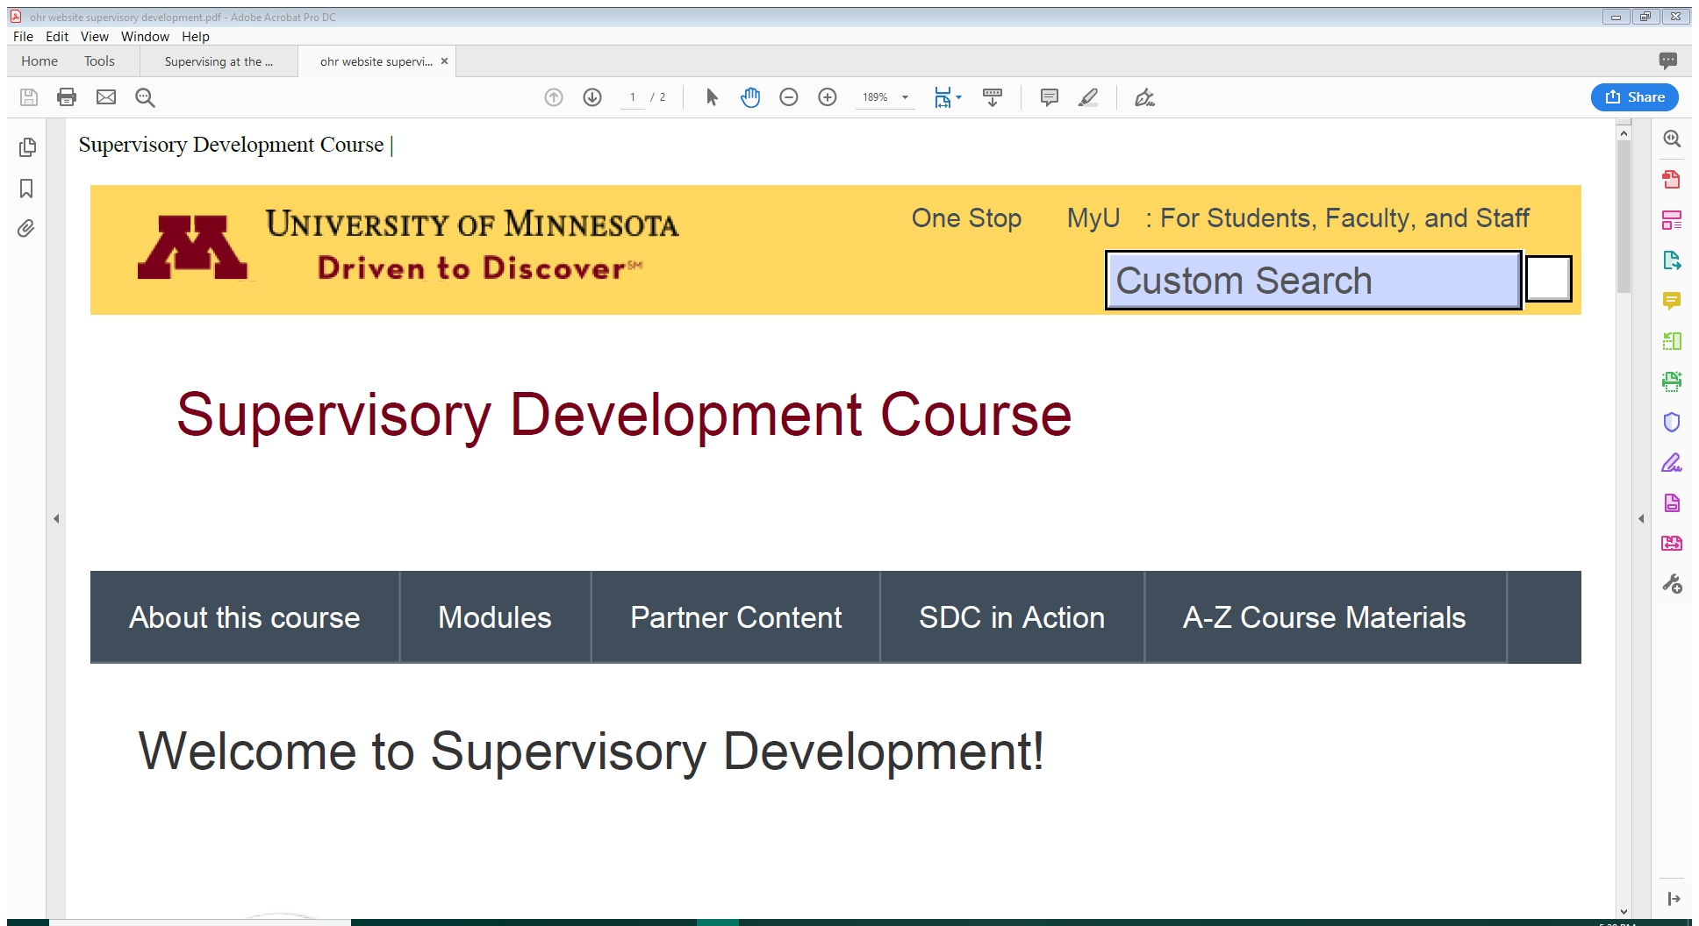
Leveraging Other Resources
We will build on the U-wide supervisory development online resources from Leadership and Talent Development.

Slide 5
Supervisory Development Program Modules
Feedback and Coaching
Managing and Evaluating Performance
Managing Conflict
Leading Teams
Employee Engagement
Onboarding New Employees
Selection and Hiring

Slide 6
What makes a good supervisor?

Slide 7
What makes you a good supervisor?
What will make you a better supervisor?

Slide 8
Leading others through change
Providing professional development coaching
Setting quality standards for employee work
Holding employees accountable for their workload
Providing actionable feedback on performance
Recognizing excellent performance
Structuring work plans that allow employees to succeed
Giving timely feedback on performance
Identifying clear team expectations
Managing conflict among team members
Using constructive problem-solving
Balancing workloads across team members
Communicating information clearly and on time
Empowering employees to excel
Welcoming and onboarding new employees
Encouraging and modeling work/life balance
Building team solidarity

Slide 9
Welcome to being a supervisor.

Slide 10
But don’t worry, you have an HR team and many University resources.

Slide 11
Rules of the Road: Three Guiding Principles

Slide 12
Principle 1: Know the pertinent rules.
Some rules at the University apply to everyone, but sometimes there are different rules for different people.
Which rules apply to everyone?
Which rules are different for different employees?

Slide 13
What are the pertinent rules governing these types of employees?
Faculty member
P&A staff member
Civil Service staff member
Labor-Represented staff member
Student employee
Graduate assistant

Slide 14
Principle 2: Ensure fair treatment.
There are differences between public and private employment.
What does this mean – perception wise?
What does this mean – in reality?

Slide 15
Due Process in a Nutshell
A public employee is owed due process before being deprived of their employment (or having employment terms impacted).
The process that is due is the process outlined in the policy, rules, or contract governing the terms and conditions of that particular individual’s employment.

Slide 16
Principle 3: Be fair.
Follow the Golden Rule and treat others as you would wish to be treated.
Recognize the influence you have as a supervisor in setting the culture for your work group.
How you govern yourself.
How you govern the environment and issues on your team.

Slide 17
Code of Conduct
Be Fair and Respectful to Others. The University is committed to tolerance, diversity, and respect for differences. When dealing with others, community members are expected to:
be respectful, fair, and civil;
speak candidly and truthfully;
avoid all forms of harassment, illegal discrimination, threats, or violence;
provide equal access to programs, facilities, and employment; and
promote conflict resolution.

Slide 18
Code of Conduct
Manage Responsibly. The University entrusts community members who supervise . . . with significant responsibility. Managers, supervisors . . . are expected to:
ensure access to and delivery of proper training and guidance on applicable workplace . . . rules, policies, and procedures, including this Code;
ensure compliance with applicable laws, policies, and workplace rules;
review performance conscientiously and impartially;
foster intellectual growth and professional development; and
promote a healthy, innovative, and productive atmosphere that encourages dialogue and is responsive to concerns.

Slide 20
Did you spot these issues?
Personal issues impacting work
Health issues impacting work
Health issues impacting attendance
Serious conflict between team members

Slide 21
When an employee has a personal issue impacting their work.
Refer the employee to the Employee Assistance Program.
Provides confidential professional consultation and referral services to address any personal or work concern that may be affecting wellbeing.
Up to eight sessions at no cost for benefits eligible employees and their dependents.
Reach by phone (888-243-5744) or email (eap@umn.edu)

Slide 22
When an employee has a personal or family health issue/event impacting attendance.
Refer the employee to consult with Sonya Johnson about leave – possibly an FMLA-covered leave.
Contact SPH HR to initiate FMLA notice and paperwork being sent to the employee.
If in doubt, hand it out.

Slide 23
When an employee has a health issue impacting their work.
Refer the employee to contact the Disability Resource Center/Ureturn.
Engage in the interactive process UReturn facilitates to determine the impact of the employee’s disability on their work and to identify the context in which a barrier is encountered so that a reasonable accommodation may be identified.
Work with UReturn and the employee to provide any reasonable accommodations.

Slide 24
Reasonable Accommodations
There is more than one way to accommodate a situation. A reasonable accommodation in the employment context must not:
Compromise essential requirements of a job
Cause undue administrative or financial hardship
Compromise the safety of the disabled person or others
Accommodations are tailored to an individual and their context, as each situation requires a unique accommodation or set of accommodations.

Slide 25
When there is serious conflict between team members.
Contact your SPH HR Consultant and brainstorm approaches to address the conflict.
Consider the services of the Conflict Resolution Office
Consultations
Facilitated Dialogues
Mediation
Formal Dispute Resolution through a Peer Hearing Process

Slide 26
Resources for Supervisors
SPH Human Resources team:
https://intranet.sph.umn.edu
University policy library
policy.umn.edu
Office of Human Resources governing documents
humanresources.umn.edu/union-relations/contracts
Disability Resource Center/Ureturn
https://diversity.umn.edu/disability/employeeservices
Employee Assistance Program
https://humanresources.umn.edu/benefits/employee-assistance
Office of Conflict Resolution
http://ocr.umn.edu/

Slide 27
Next Steps
Qualtrics Survey
Self assessment
Shaping the program
March/April sessions focused on conducting performance evaluations
Topics of future sessions determined with your help
Roughly every other month for sessions
Building informal resources and connections

Slide 28
Questions & Discussion
SPH Human Resources Team
Learn more: isph.umn.edu

